Slide 1
CA03 Digital Receipt Keeper Greener Kabi Li Chen

Slide 2
What is receipt?
Receipt plays a significant role in
record-keeping, financial management, and legal protection
Receipt
Proof of Purchase:
tax purposes
Warranty Claims
Expense Tracking
Business Record
Audit Trails

Slide 3
What is happening?
More and more businesses are transitioning to digital receipts to customers via SMS messages.
According to ATO, paper receipts generally cost more to process than digital receipts.
Digital receipts help save paper and reduce environmental impact.
Digital receipt is great solution
but
Sharing mobile numbers publicly presents
inconveniences and privacy concerns!

Slide 4
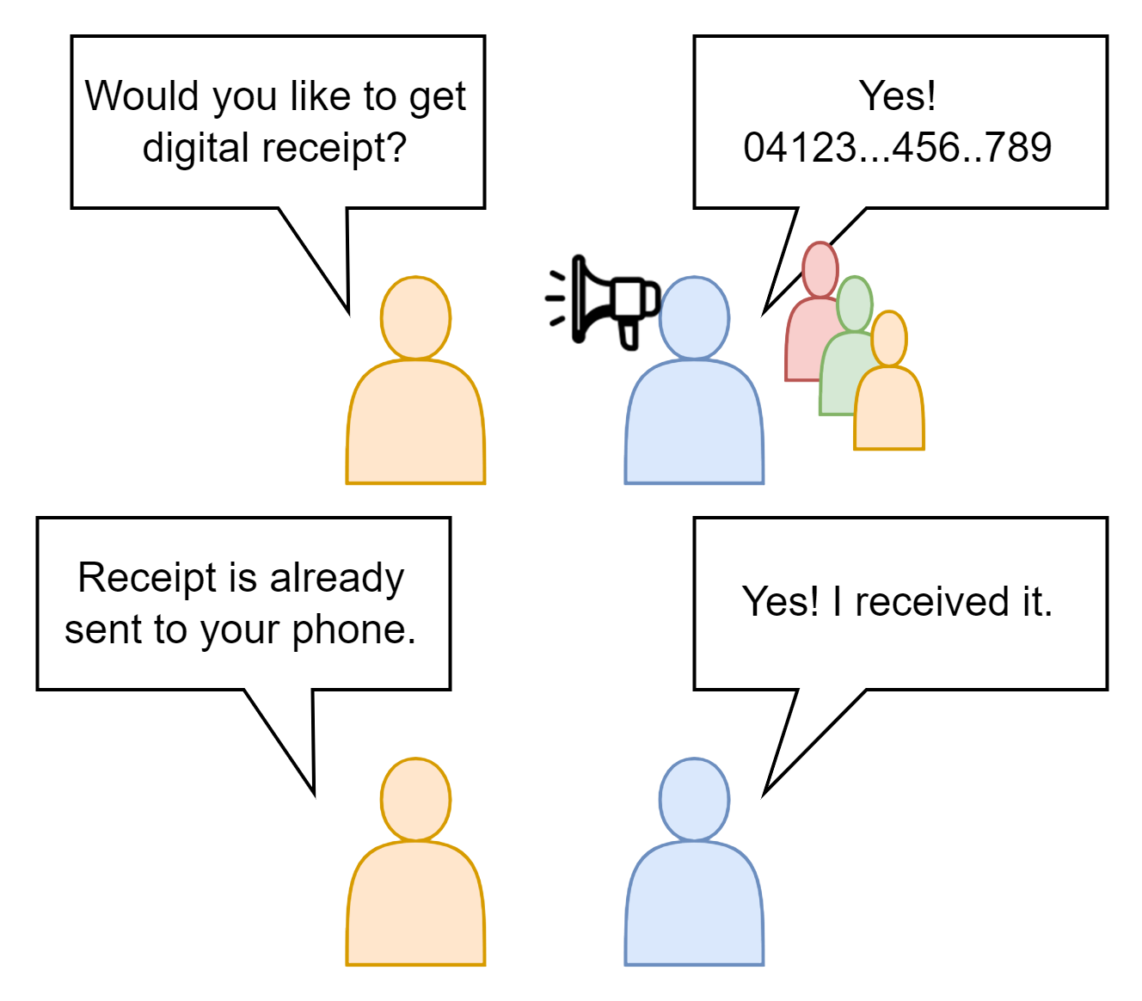
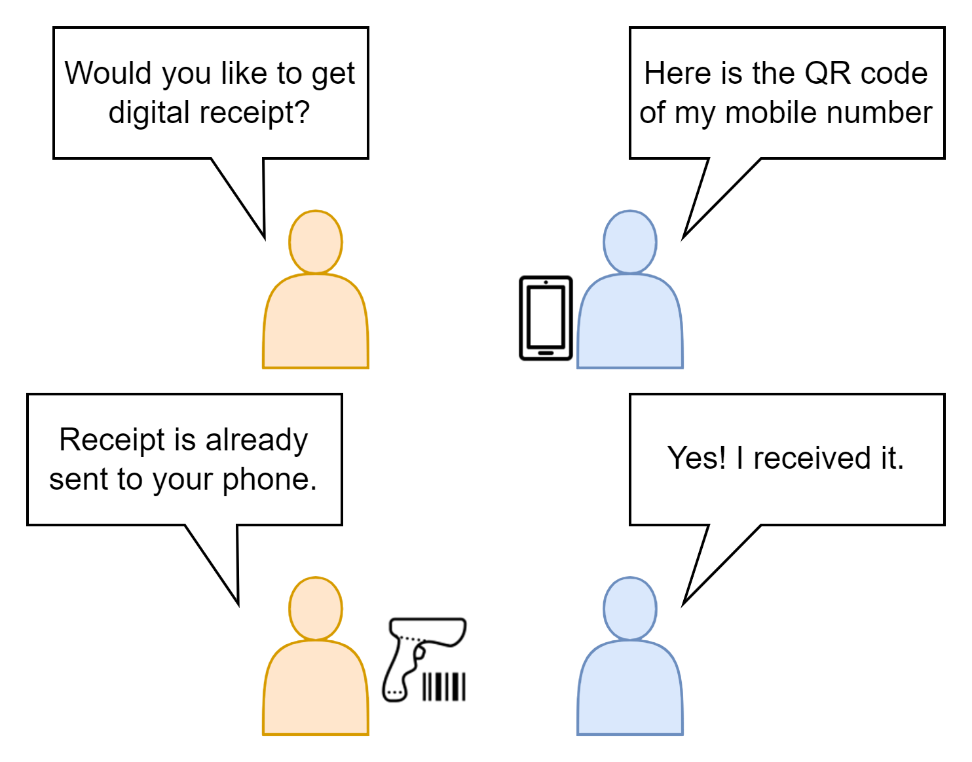
Digital Receipt Keeper = Solution to All
A web application suits for all mobile platforms.
Streamline receipt management, making it effortless to organize receipts for future references.
Generate mobile number barcodes for receiving digital receipts securely and conveniently.
Reduce the risk of personal information exposure when providing contact details to businesses.
Before
With Digital Receipt Keeper

Slide 5
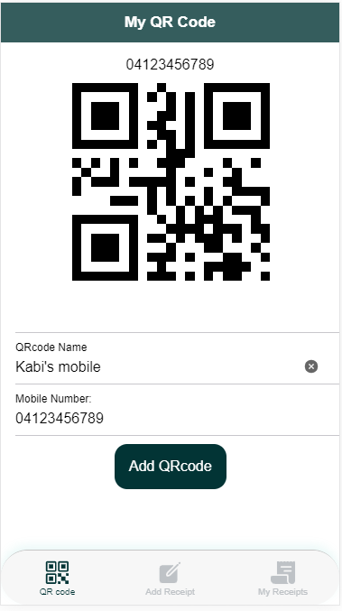
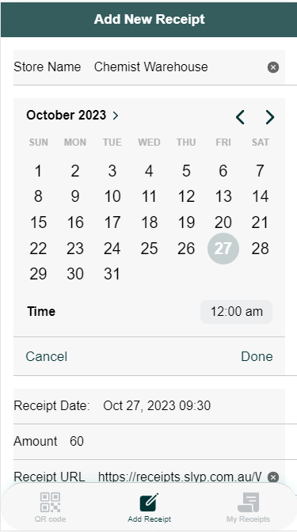
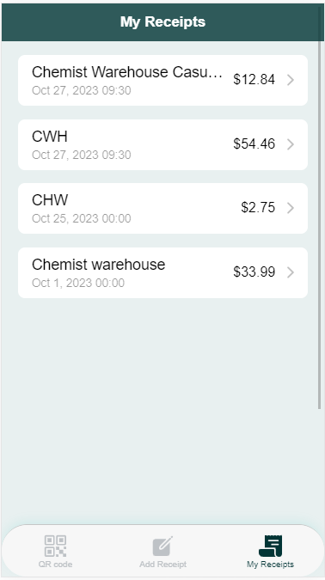
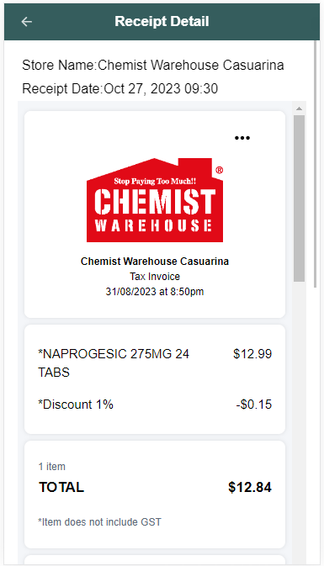
Digital Receipt Keeper UI

Slide 6
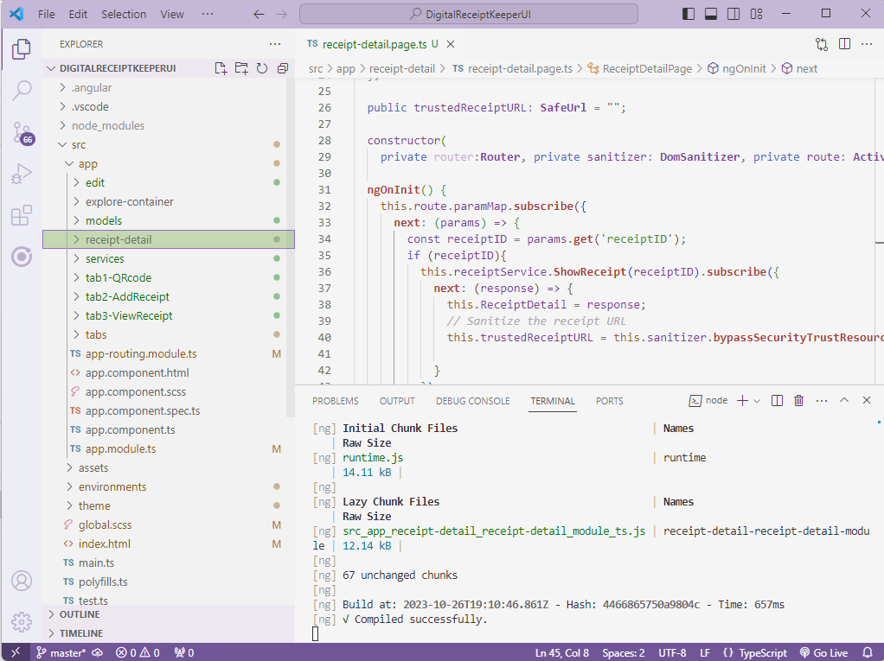
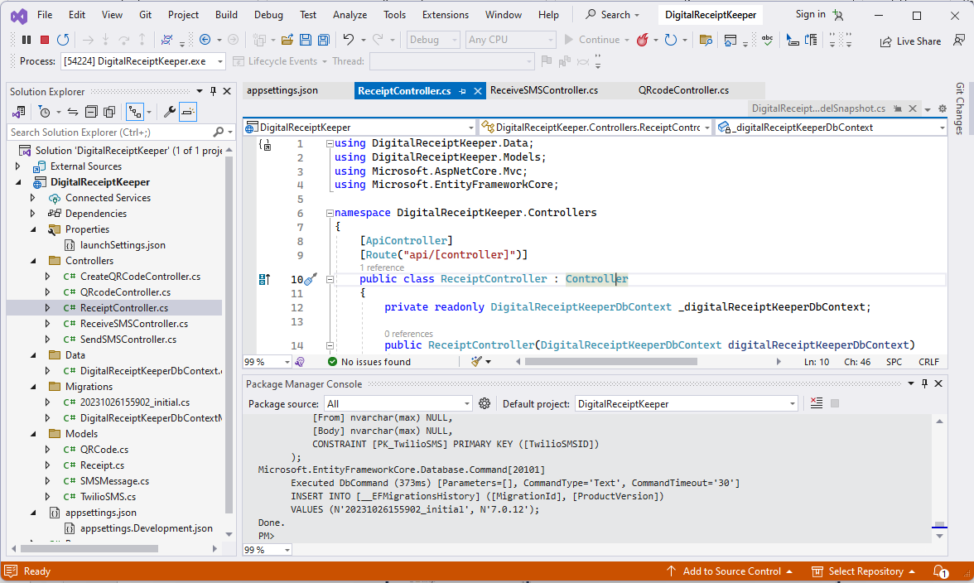
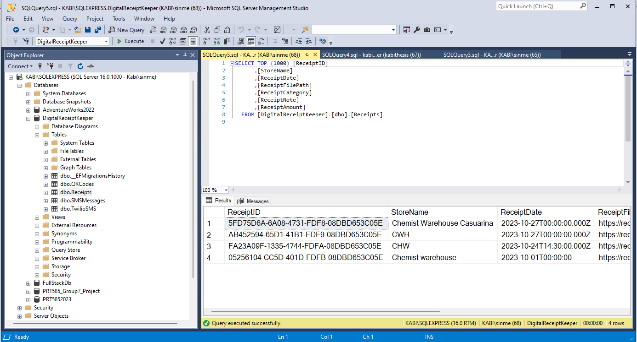
Tools and Techniques
Front End: Angular
Back End: .NET 7 with MVC Framework
Database: MSSQL

Slide 7
Our Team
Kabi Li 04-781-292-36 Sinmei_li@hotmail.com
Chen Chen 04-321-695-25 Chenchen1621@gmail.com
Thank you ☺

